Slide 1
Vigilancia : the student monitoring system
Name : Khushi panwar
B.Sc (H) Cs, 1st year
srcas-w, University of delhi

Slide 2
Before we begin, I would like to ask you that what is the major change occurred in the past two years?? This change was unexpected and very unpredictable but now we’re living with that change. Would anyone like to answer??
Due to prevailing pandemic, most of the workplaces and educational institutions shifted to the online mode.

Slide 3
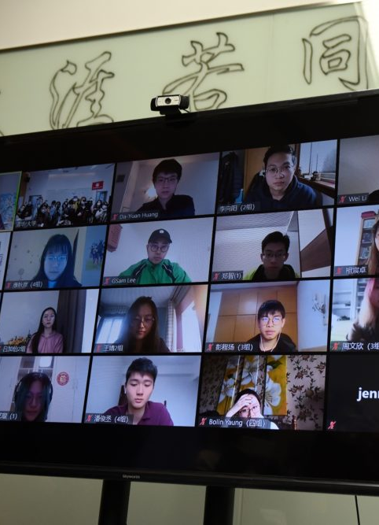
Shift of all educational institutions to the
“online mode”
In order to take the necessary precautions, All the classes and exams shifted to online mode due to prevailing pandemic.
Although online mode offered a solution that the education shouldn’t stop at any cost. It also gave us a big issue/trouble of cyber or online cheating.
Hence, giving the students an opportunity to cheat and take help of various resources in their tests/exams.

Slide 4
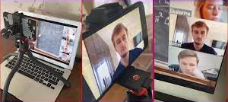

IF EXAMS IN
ONLINE MODE IS A PROBLEM,
THEN WHAT IS THE SOLUTION??

Slide 5
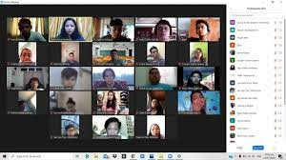
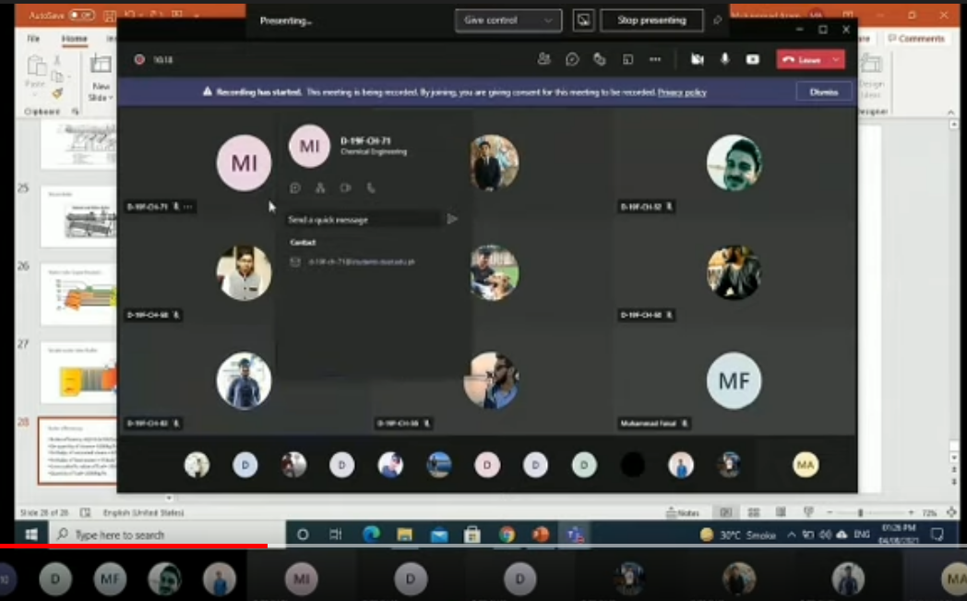
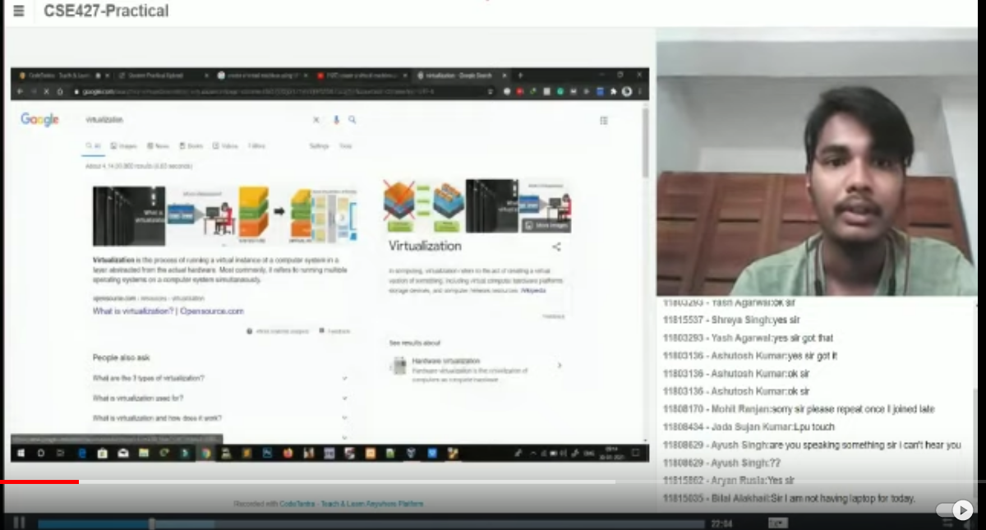


Vigilancia
Say yes to sincere exams
No more cheating mode!

Slide 6
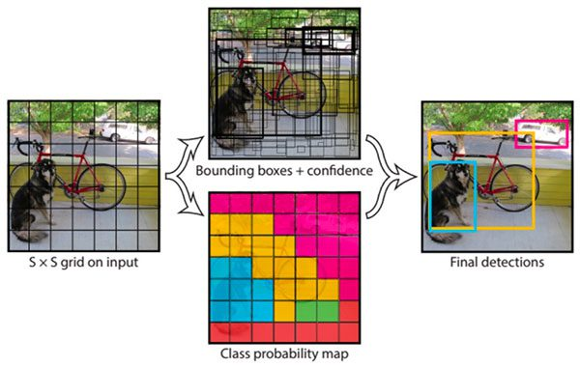

PRIME THEME OF VIGILANCIA
Vigilancia would be primarily work on the detection and recognition system specially modified for students at the video conferencing level.
1. Object Recognition & Categorization
Face detection
Notification & recording system

Slide 7


Detection of objects: How is it done in vigilancia?
Output of normalized correlation- template
Matching or finding incidents of a pattern
This is a chair
Find the chair in this image
Recent techniques in detection & recognition have leveraged machine learning techniques in combination with lots of training data.
Popular programming languages including Python, Java, Scala – data processing & web development, Javascript etc to make such application.

Slide 8

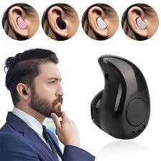
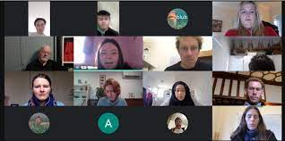



PRIME FEATURE OF VIGILANCIA : Detection of cheat entities
Detection of objects like ear pods, phones, PC/Laptop screens, glasses, books, cheating sheets, etc would be programmed into the application and a notification would be sent if the student uses any of these objects.

Slide 9









Do these images contain faces??
VIGILANCIA ACCURATELY DETECTS THE FACES

Slide 10
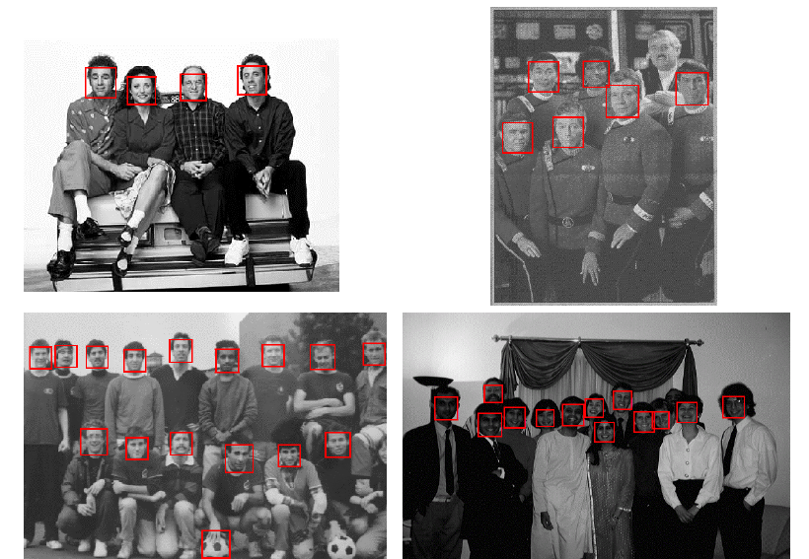
Vigilancia distinguishes students via FACE & SKIN DETECTION

Slide 11
ADVANTAGES OF VIGILANCIA
VIGILANCIA (the monitoring application) would be helpful in monitoring large number of participants/students during an online exam.
Detection of objects like ear pods, phones, PC/Laptop screens, glasses, books, cheating sheets, etc would be programmed into the application and a notification would be sent if the student uses any of these objects.
The notification would also be sent if the student’s screen is frozen for a longer time or even turned off for more than a minute.
Vigilancia can be made available both in tailor made versions & free of cost open source versions.
Additional features can be incorporated as this will be open source system.

Slide 12
Where can vigilancia be used?
Used by any institution or organization who conduct exams in online mode.
Not only limited to schools or colleges, it can be helpful in the state or govt. affiliated exams where the decisions are final and abiding.
Also by the companies or organizations who are in need of new employees and have to shifted to online mode to select the canditates.

Slide 13

THANK YOU!
Hope you liked the idea of Vigilancia – the student monitoring system.

